Slide 1
PROJECT COMPASS
(AIPM 02: capstone project)
Group 4
Archana Subramoney
Kumar Gyanam Nehal Naphade
Shweta Shah
Ikshit Mistry

Slide 2
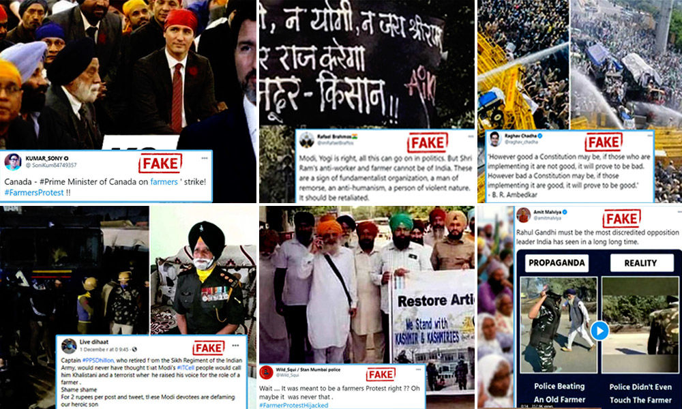

CONTENT AND ITS RELEVANCE IS CHANGING OUR CONNECT EVERYDAY
70%
61%
.
People who prefer social media for news are more likely to share made-up news and information than those who prefer other pathways
User generated content makes the content more authentic and helps to connect with people
Of people trust Images taken from ‘people like them’ over brand created Images
Of people would be more likely to engage with an advertisement if it contained user-generated content

Slide 3



Where Integrity is your Identity
USER GENERATED
Pixstory is a new social media platform committed to transparency, integrity, and decency in which users are held accountable to the truth. Pixstory addresses a critical gap in existing social media spaces by creating a platform that is reliable, safe, and evidence based. As with other social media apps, Pixstory users can post photos and stories and engage with the content posted by other users. What sets Pixstory apart is that it provides an innovative multi-dimensional template for displaying posts that allows users to challenge inaccuracies or abuse and support quality content.
AUTHENTIC INFORMATION
MISSION 01
MISSION 02
MISSION 03
MISSION 04
Aim is to lead a behavioral shift in social media space. Values - Honesty, integrity and accountability
Content is curated through the contribution of the users in form of posts, videos, images etc.
Each content is ranked by integrity scores using 3 step “Truth Filter”
Truth filter helps to weed out hate and discrimination

Slide 4
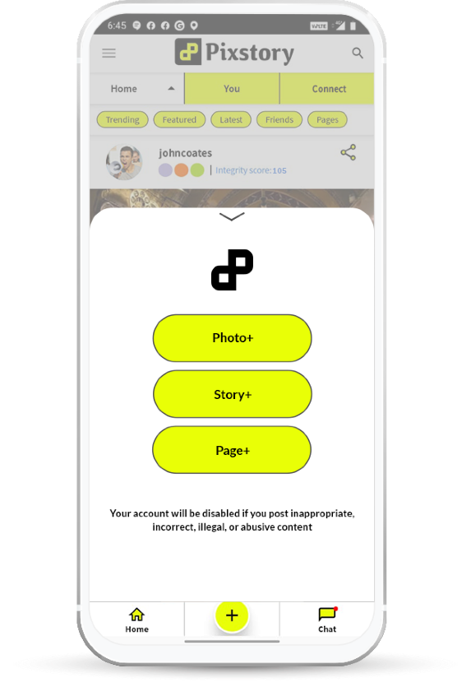
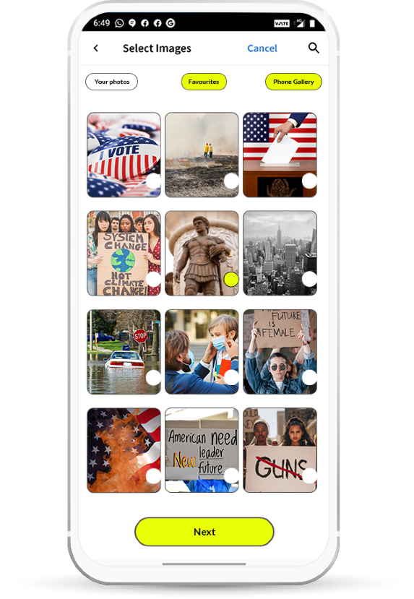
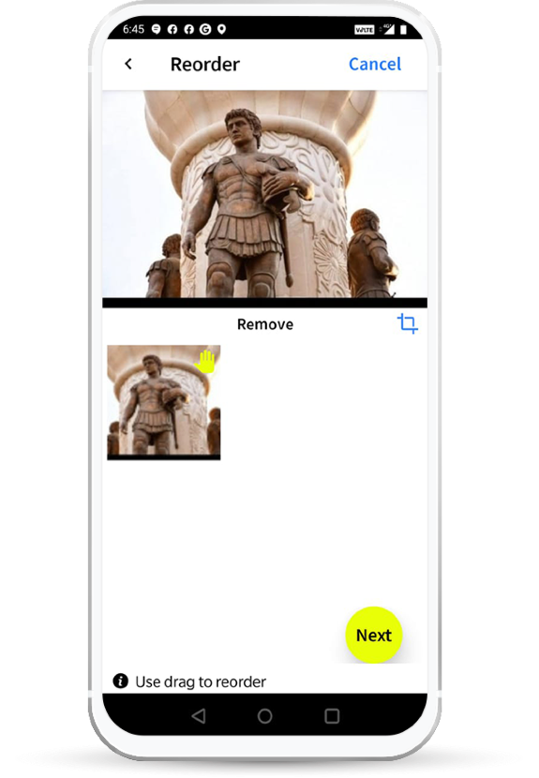
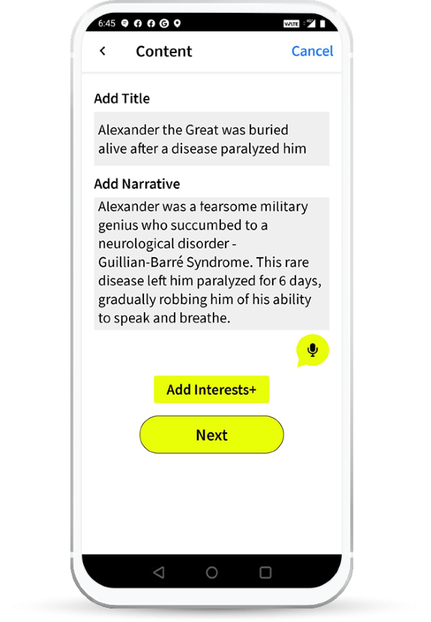

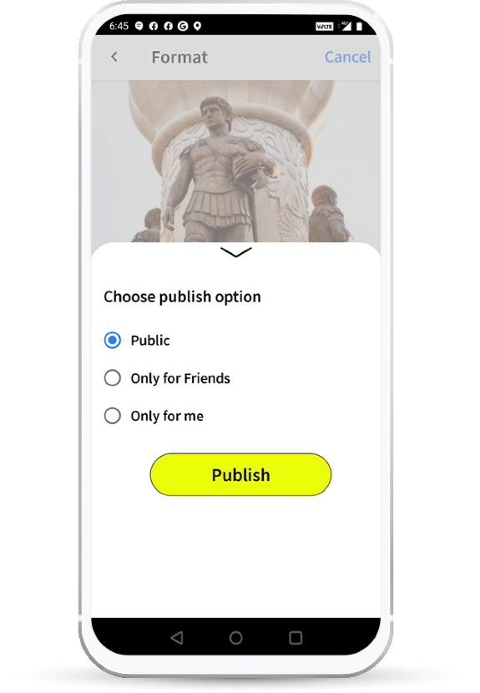
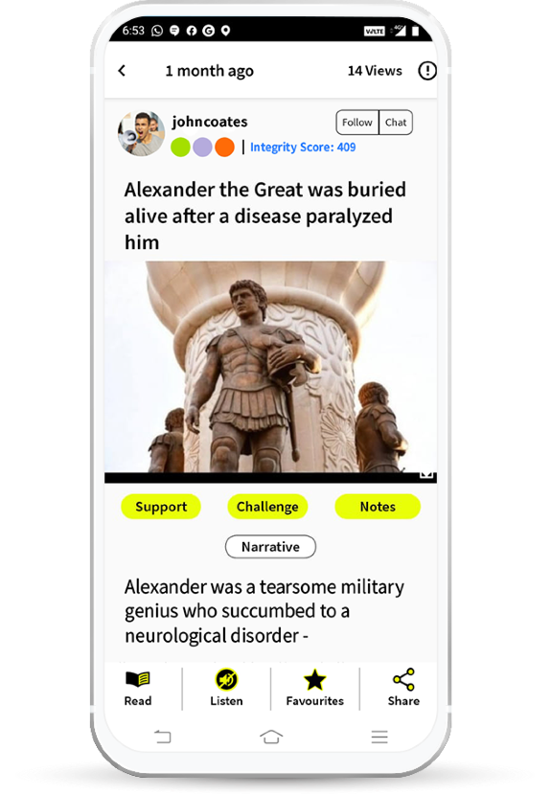
1,2,3 AND YOUR CONTENT IS PUBLISHED: SIMPLE!!
1
3
CREATE
PUBLISH
2
Contributors can "support" and "challenge" stories and earn a higher Integrity Score
Challenges to a story are reviewed by SME
ADD THE STORY

Slide 5
PROBLEM STATEMENTS
Data proves that 75-80% readers do not scroll more than once on the app. (1-2 story views)
While they felt content was great, they would like to be able to find out their favorite topics easily
Disengaged user & Lack of stickiness to the App influence negatively in other forums. Company thrives on user driven authenticity and content marketing
In a user driven content marketing: interest tagging is pivotal to navigate users to the right content and increase engagement index

Slide 6
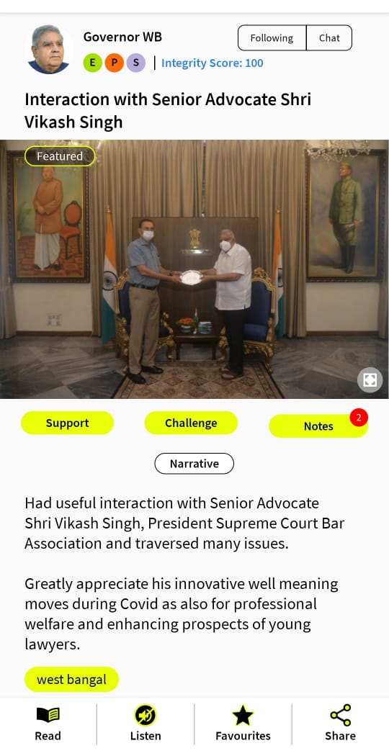
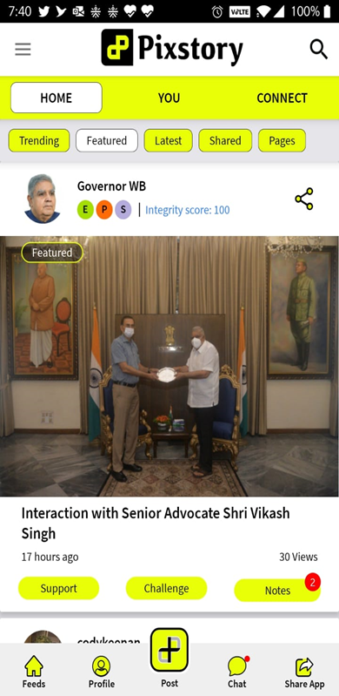
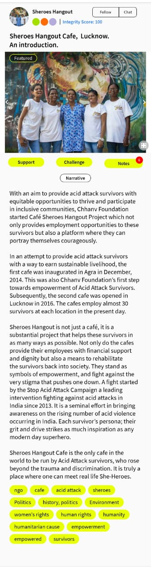
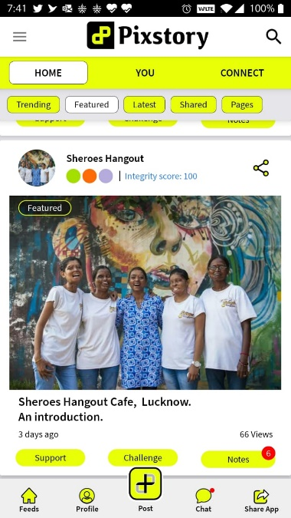
POSTS
Users’ input for interest typically constitute of very few, very generic or vaguely connected tags to the story.
On the other hand, user input for interest are without much relevance to the story or too many.

Slide 7
PROPOSED SOLUTION
Building a content-based recommendation engine, to suggest the relevant content to the reader.
Refreshing the recommendation engine by adding new articles every 3 – 4 hours
Running the clustering code every 2-3 months incase new clusters can be formed
Refreshing the interest tags and removal of non relevant user generated tags

Slide 8
Making clusters using keyword
1
Create cluster using k means clustering – 3 clusters
2
Loading and cleaning the dataset
Create a corpus
Text Analytics & Clustering
Revisit the clusters every 1-2 months
convert to lower case
3
SOLUTION DESIGN
5
Generated Bag Of words
Remove punctuation, num & white space
Generate the DTM & Remove 1% Sparce
Remove stop words
4
K-Means Optimization
Sort by cluster and review results

Slide 9
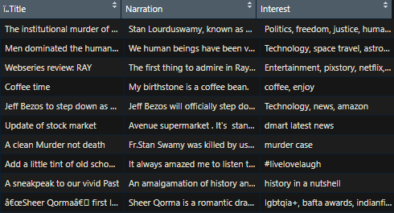
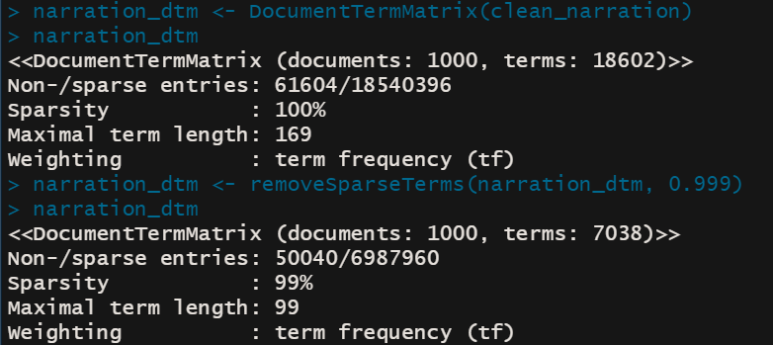
DATASET FLOW
3 VARIABLES
Document Term Matrix
REMOVED 1% SPARSITY
Loading and cleaning
the dataset
Create a corpus
Remove punctuation,
stop words, num, white space
convert to lower case
Generate the Document
Term Matrix,
Remove 1% Sparce terms, Bag Of Words
TEXT ANALYTICS

Slide 10
CLUSTER ANALYSIS
Making clusters using keyword
Create cluster using
k means
clustering – 6 clusters
K-Means
Optimization
Sort by cluster and review results
Elbow graph showing
the optimal number
of clusters are 6
STRATEGIC GAP

Slide 11
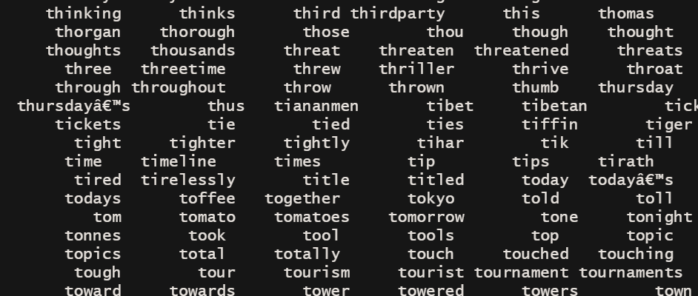
HOW IS THE CLUSTERING DONE?
Keywords Extracted From The Narratives
Parameters used for clustering
Cluster Numbers Assigned Based On The Common Words In Each Narrative
AVAILABLE COMPONENTS:
"cluster" "centers" "totss" "withinss" "tot.withinss“ "betweenss" "size" "iter" "ifault"

Slide 12
Load the Document
Term Matrix
Identify distance between 2 articles
Applying the function to show results
RECOMMENDATION
ENGINE
Keyword * Article Number
Cosine Function
Recommendation
1000 observations x 6522 Variables
(mat.df = as.data.frame(data.matrix(narration_dtm), stringsAsFactors = FALSE)
cosine_sim <- function(a, b) dot(a,b)/sqrt(dot(a,a)*dot(b,b))
cos_sims <- apply(Newsarticle, 1, FUN = function(y) cosine_sim(Newsarticle[4,], y))

Slide 13
RECOMMENDATION ENGINE RESULTs
1. Coffee Houses as Addas: brewing plenty of action 1
When life gives you empty Nutella jar, you make coffee in it 1
3. What's the coffee nap ? 1
Beat the Monday Blues! 1
Chocolate mousse - youâ€™ll never guess the secret ingredient!
1. Football dreams: I am Maram,
2. NFL: Football is gay. Football is queer. Football is for everyone.
3. My football dream: I am Saleha Kashfi,
4. Football dreams: I am Maria Romanchenko, 17, Ukraine 1 0.4050322
5. England vs Germany is overhyped 1 0.2611474 6 ï¿½ï¿½.
Example 1 based on Content
Example 2 Based on Content

Slide 14
DEPLOYMENT
Strategy

Slide 15
Why do we say
“DEPLOYMENT STRATEGY”
Deployment is the method by which you integrate a machine learning model into an existing production environment to make practical business decisions based on data.
Venturebeat reports that 87% of data science projects never make it to production, while redapt claims it is 90%.
Collaboration and iteration as a team is critical
Deploying machine learning models is more of an art than science.
Deployment requires skills of a software engineering and DevOps
Disconnect between IT and Data Scientists. Bridging the gap between those two worlds is key

Slide 16
SWOT - Pixstory
T
S
Threats
The giants of social media has no clear-cut policy on fake news, why they have ban someone with or without notice, it is because of various political and social pressure. The platform will face strong push back once people start noticing it.
O
W
Strength
Young team, ready for experiment, working towards changing the way people consuming and looking at news.
Opportunity
There is a huge gap in social media on trust. Generally user doesn’t trust any news they see and there is almost no way to find out if the information is correct or not. Also, user spread fake news without knowing its fake and there is no method to correct the information at its source.
Weakness
Currently no revenue plan, high dependency on investors and going back to investors for each modification or cost related implication.

Slide 17
MANPOWER
Pixstory is a start-up and work with minimal manpower, currently we do not have data science or deployment team. It will lead us to many challenges while deploying the product.
TECHNOLOGY
DEPLOYMENT
The deployment will need tech support, currently we are using AWS server and as we all know it is charged as per the use. This implies more cost.
PROBLEMS
OTHER
The problem we are trying to solve here is retention. Currently we have research data which shows that people are demanding relevant content. Deploying in the real time and test it with user will be challenge specially user are wide variety in terms of demography and taste.

Slide 18
DEPLOYMENT: TECHNOLOGY PERSPECTIVE
On-premise, in cloud storage, or in a hybrid of the two; if the data is large, while data stored in cloud storage systems like GCS, AWS S3, or Azure storage should be matched with cloud ML training and serving. Inference will be done in batches, Inference data will be from webpages: JSON, CSV
Language Python, frameworks like TensorFlow, Pytorch, and Scikit-Learn for training models
Regular feedback and monitoring of the models, keep the model basic, scalable. TFX supports a feedback mechanism that can be easily used to manage model versioning as well as rolling out new models.
Starting with a simpler model is often the right approach to establish a baseline. Considerations at this point include precision requirements, accountability, explain ability, and alignment with business and regulations.
DATA STORAGE AND RETRIEVAL
FRAMEWORKS AND TOOLING
FEEDBACK AND ITERATION:
THE A OF DEPLOYMENT

Slide 19
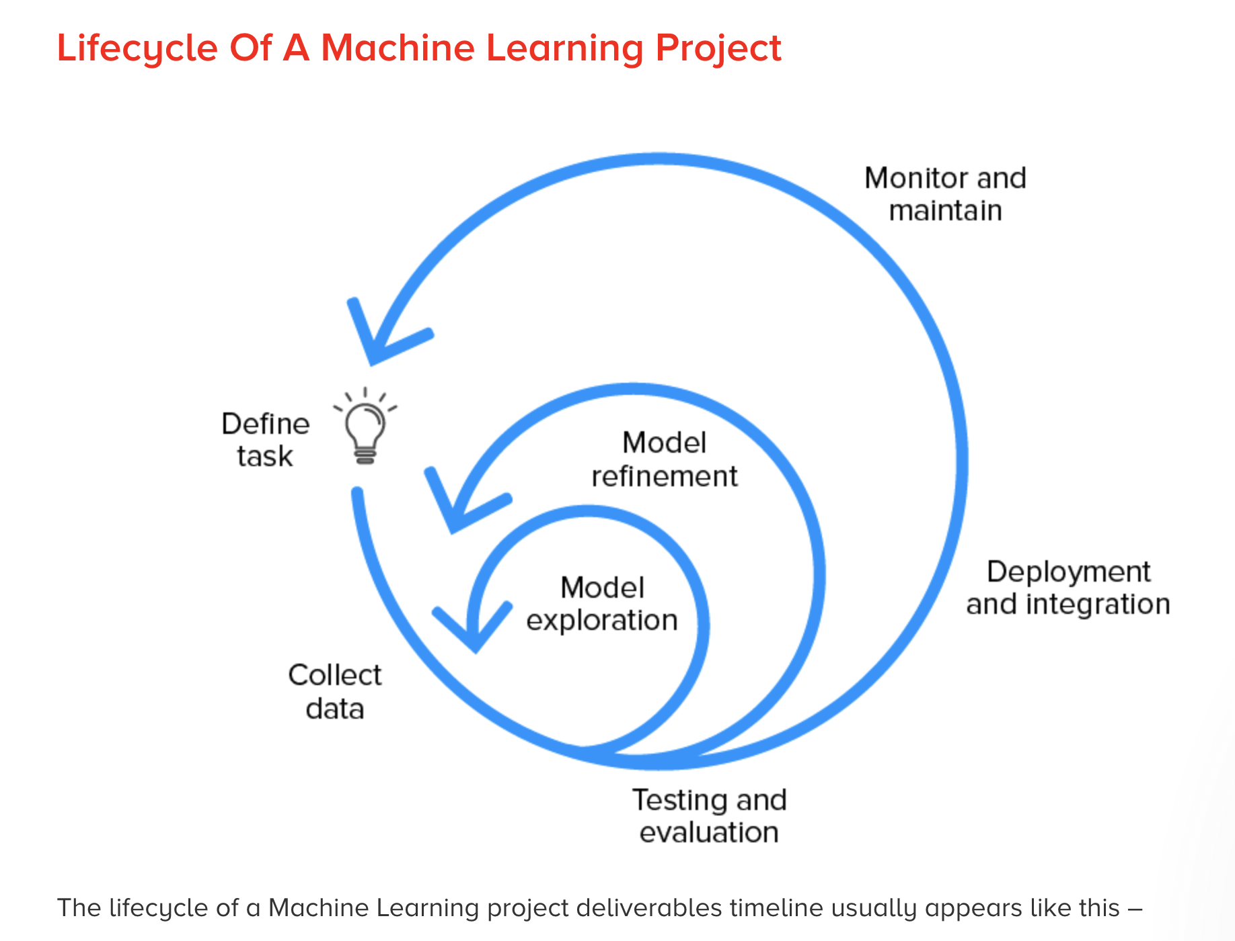
LIFECYCLE OF A MACHINE LEARNING PROJECT
Establish the baseline for model performance | Create a simple model with initial data pipeline | Try parallel ideas during the early stages | Find the SoTA model for the problem domain, if any, and reproduce results
Evaluate the model on test distribution | Revisit the model evaluation metric, ensuring it drives desirable user behaviour | Write tests for – model inference function, input data pipeline, explicit scenarios expected in the production.
01
03
05
Define the task and requirements | Identify the project feasibility
Discuss the general model tradeoffs | Create a project codebase
ML Project Plan Setup
Model Exploration
Test and Evaluate
02
04
Collection and
Labelling
of Data
Refinement of Model
Create the labelling documentation | Build the data ingestion pipeline | Validation of data quality
Do model-centric optimizations | Debug models as complexity gets added | Conduct error analysis for uncovering failure modes.
The lifecycle of a Machine Learning project deliverables timeline usually appears like this -

Slide 20
LIFECYCLE OF A MACHINE LEARNING PROJECT
Establish the baseline for model performance | Create a simple model with initial data pipeline | Try parallel ideas during the early stages | Find the SoTA model for the problem domain, if any, and reproduce results
Evaluate the model on test distribution | Revisit the model evaluation metric, ensuring it drives desirable user behaviour | Write tests for – model inference function, input data pipeline, explicit scenarios expected in the production.
01
03
05
Define the task and requirements | Identify the project feasibility
Discuss the general model tradeoffs | Create a project codebase
ML Project Plan Setup
Model
Exploration
Test and Evaluate
02
04
Create the labelling documentation | Build the data ingestion pipeline | Validation of data quality
Collection and
Labelling
of Data
Refinement of Model
Do model-centric optimizations | Debug models as complexity gets added | Conduct error analysis for uncovering failure modes.
The lifecycle of a Machine Learning project deliverables timeline usually appears like this -

Slide 21
LIFECYCLE OF A MACHINE LEARNING PROJECT
Establish the baseline for model performance | Create a simple model with initial data pipeline | Try parallel ideas during the early stages | Find the SoTA model for the problem domain, if any, and reproduce results
Evaluate the model on test distribution | Revisit the model evaluation metric, ensuring it drives desirable user behaviour | Write tests for – model inference function, input data pipeline, explicit scenarios expected in the production.
01
03
05
Define the task and requirements | Identify the project feasibility
Discuss the general model tradeoffs | Create a project codebase
ML Project Plan Setup
Model
Exploration
Test and Evaluate
02
04
Create the labelling documentation | Build the data ingestion pipeline | Validation of data quality
Collection and
Labelling
of Data
Refinement of Model
Do model-centric optimizations | Debug models as complexity gets added | Conduct error analysis for uncovering failure modes.
The lifecycle of a Machine Learning project deliverables timeline usually appears like this -

Slide 22
LIFECYCLE OF A MACHINE LEARNING PROJECT
Establish the baseline for model performance | Create a simple model with initial data pipeline | Try parallel ideas during the early stages | Find the SoTA model for the problem domain, if any, and reproduce results
Evaluate the model on test distribution | Revisit the model evaluation metric, ensuring it drives desirable user behaviour | Write tests for – model inference function, input data pipeline, explicit scenarios expected in the production.
01
03
05
Define the task and requirements | Identify the project feasibility
Discuss the general model tradeoffs | Create a project codebase
ML Project Plan Setup
Model
Exploration
Test and Evaluate
02
04
Collection and
Labelling
of Data
Refinement
Of
Model
Create the labelling documentation | Build the data ingestion pipeline | Validation of data quality
Do model-centric optimizations | Debug models as complexity gets added | Conduct error analysis for uncovering failure modes.
The lifecycle of a Machine Learning project deliverables timeline usually appears like this -

Slide 23
LIFECYCLE OF A MACHINE LEARNING PROJECT
Establish the baseline for model performance | Create a simple model with initial data pipeline | Try parallel ideas during the early stages | Find the SoTA model for the problem domain, if any, and reproduce results
Evaluate the model on test distribution | Revisit the model evaluation metric, ensuring it drives desirable user behaviour | Write tests for – model inference function, input data pipeline, explicit scenarios expected in the production.
01
03
05
Define the task and requirements | Identify the project feasibility
Discuss the general model tradeoffs | Create a project codebase
ML Project Plan Setup
Model
Exploration
Test and Evaluate
02
04
Create the labelling documentation | Build the data ingestion pipeline | Validation of data quality
Collection and
Labelling
of Data
Refinement
of Model
Do model-centric optimizations | Debug models as complexity gets added | Conduct error analysis for uncovering failure modes.
The lifecycle of a Machine Learning project deliverables timeline usually appears like this -

Slide 24
LIFECYCLE OF A MACHINE LEARNING PROJECT
06
Deployment of Model
Expose the model through REST API| Deploy the new model to a subset of users to ensure that everything is smooth before the final rollout.
| Have the ability to roll back the models to its previous version | Monitor the live data.
07
Model Maintenance
Create the labelling documentation | Build the data ingestion pipeline | Validation of data quality
The lifecycle of a Machine Learning project deliverables timeline usually appears like this -

Slide 25
LIFECYCLE OF A MACHINE LEARNING PROJECT
06
Deployment of Model
Expose the model through REST API| Deploy the new model to a subset of users to ensure that everything is smooth before the final rollout.
| Have the ability to roll back the models to its previous version | Monitor the live data.
07
Retrain the model for preventing model staleness |
Educate the team if there is a transfer in the model ownership
Model Maintenance
The lifecycle of a Machine Learning project deliverables timeline usually appears like this -

Slide 26
DEPLOYMENT :
BUSINESS PERSPECTIVE
1
2
3
Present the top use cases that this Project Compass will cover as per our Industry to strengthen PixStory’s position with the competitors
Agree upon Acceptance criteria for the adoption of the model
Time this model will take to produce favourable results to the business: 2 quarters Min
4
5
6
Funding we need to deploy this recommendation system
Resource exploration: ML engineers in house, Outsource this project, deprioritize other projects to show some quick wins?
Product and Marketing team to work closely with the ML engineers

Slide 27
AGREEING ON MEASUREMENT AND SUCCESS CRITERIA:
01
How many shares, Support, Challenge
02
Time spent on the App
03
DAU and MAU
04
Engagement Index
05
FGDs with few Alpha users
06
User experience scores

Slide 28
DIGITAL
STRATEGY

Slide 29

Rethink Color scheme for the APP: E.g.: Analogous, Triadic etc.
Add ability to rate or review the Stories
Depiction of Integrity score needs to be elevated
IMPROVING
Ability to refresh Stories to get the latest feed should be added
APP
More details to create personas while registering can be added: Geography, Age, more narrowed down interests etc.
Clear CTA’s while using Support, Challenge and Note buttons should be added

Slide 30
User persona creation
18-22, college going, male/female, urban, may/may not consume news but active in social media. 35-50, M/F, service/business consumes news from different sources.
Content Marketing:
- Blogs - Infographics - Case studies - Impact SEO positively - NSMCWLP
DIGITAL
Pay Per Click:
- Geotargeting - Burst campaign
STRATEGY
User contribution Strategy:
contest, engagement with users, discussion thread, UGC sharing, referrals, Viral loops-affiliate
Cross Promote:
to other social media channels
Exploration:
Using Influencer network, Specific content

Slide 31



SEO | good for google but missing out on Bing | Bing, Google | Bing, Google | Bing, Google
Notification | Only when certain action taken | Yes, immediately on logging | No | Started recently
Contribution | Reporters, columnists and editors. Equity: Shekhar Gupta | collective of reporters, storytellers, editors, producers, designers, and analysts | Voluntary consists of engineers, social activists, journalists and scientists General public can also contribute | UGC
Ad revenue | Yes, targeted ads+ inventory. PR articles | Yes | No | No
Model | Subscription | Freenium, pay and support option with plans for every type of user | Subscription, donation | Free now
Additional features | Space for opinion, chatbot to help to navigate | My report: UGC through WebQoof Key news which get drowned due to primetime Opinion section | Fact-check feature including the methodology, Use of PTI | User badges Integrity score Review: Subject matter experts
Tags | Politics, governance, economy, defense, opinion, health, education, diplomacy, science, features | WebQoof, Elections 2022,cryto, My report, Brand studio, Podcast, Good_news, sports, education, news, Indian American, Opinion, Gender, technology | Political fact checking, Social media rumors Mainstream media misinformation and bias | Technology, history, food, entertainment, sports, science, inequality, education, health, politics, economy, climate change
User experience | Clear CTAs, format- mix of print and rich media, newspaper template, Hindi language news, incentives stickiness | Hindi language, Gender focus: all sections of society covered Regional stories Format: videos, op-eds, infographic, animations Content well segmented- based on content, format | Hindi Language website, good mix of images and text, each article well branded | Chat option between members Text and Image Users can support or challenges the posts CTA: download App
Channels | Website, social media, youtube, app, LinkedIn, Telegram | App, documentaries, SM, youtube | Website, social media, youtube, app | Social media, LinkedIn
Positioned | Online newspaper | driven by the truth and the readers who seek it | Authentic website to debunk misinformation | Social media platform that is reliable, safe and evidence based
COMPETITOR ANALYSIS

Slide 32
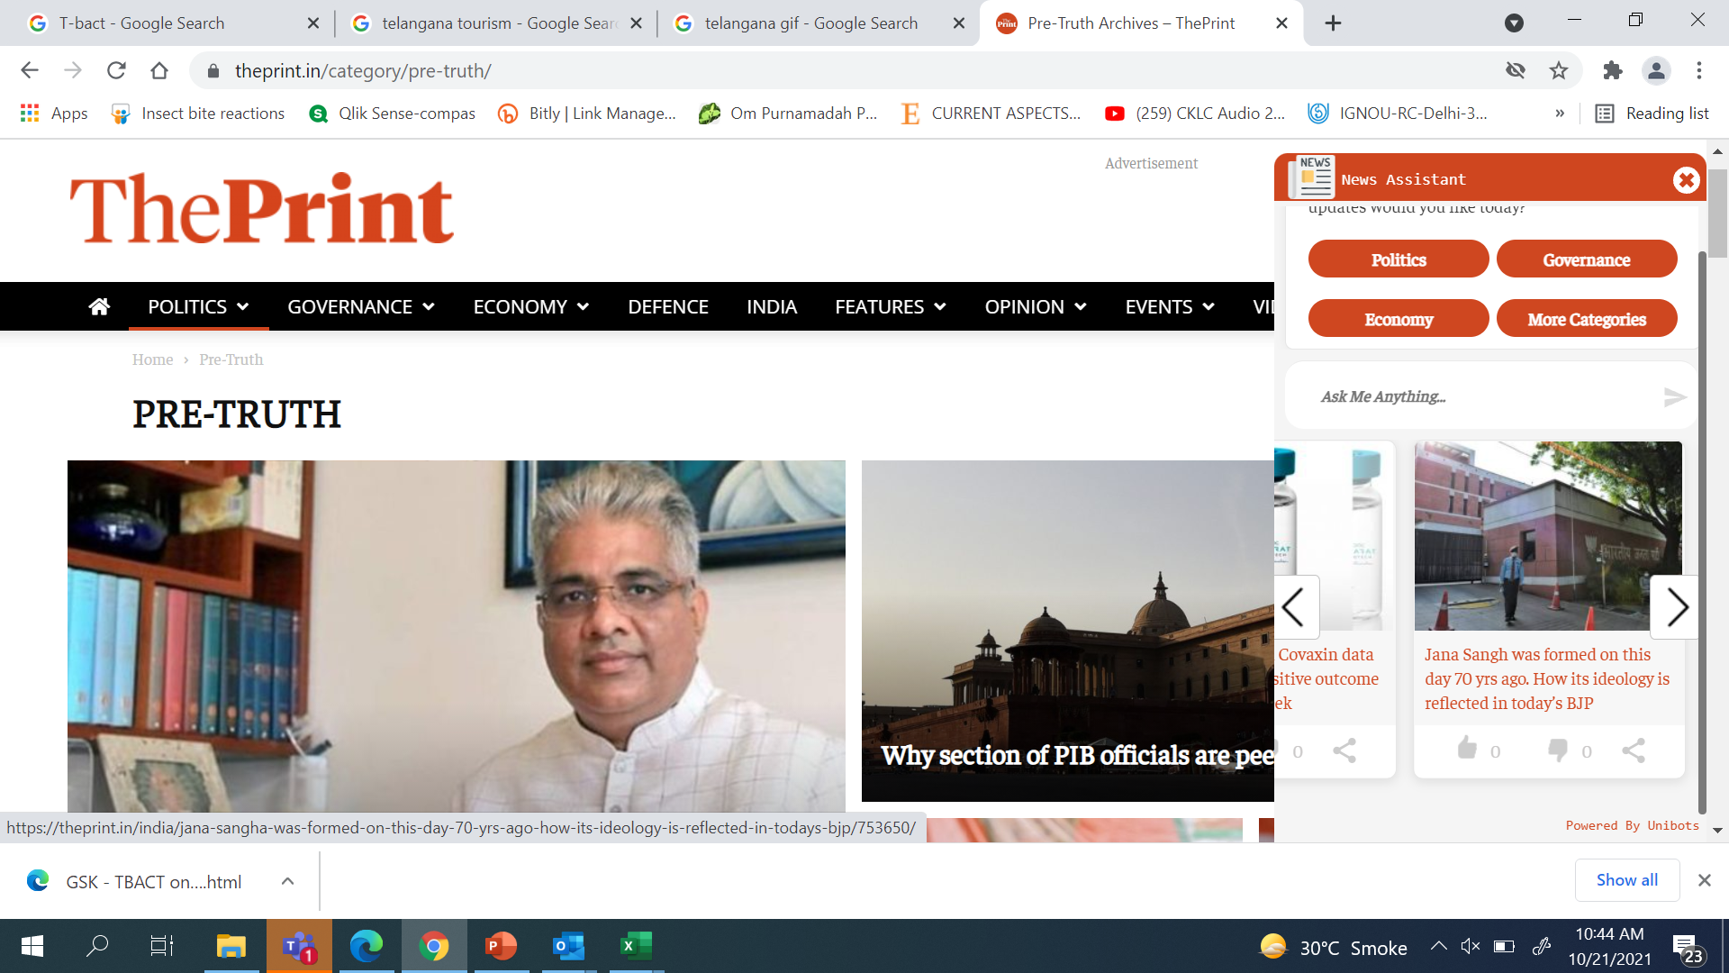
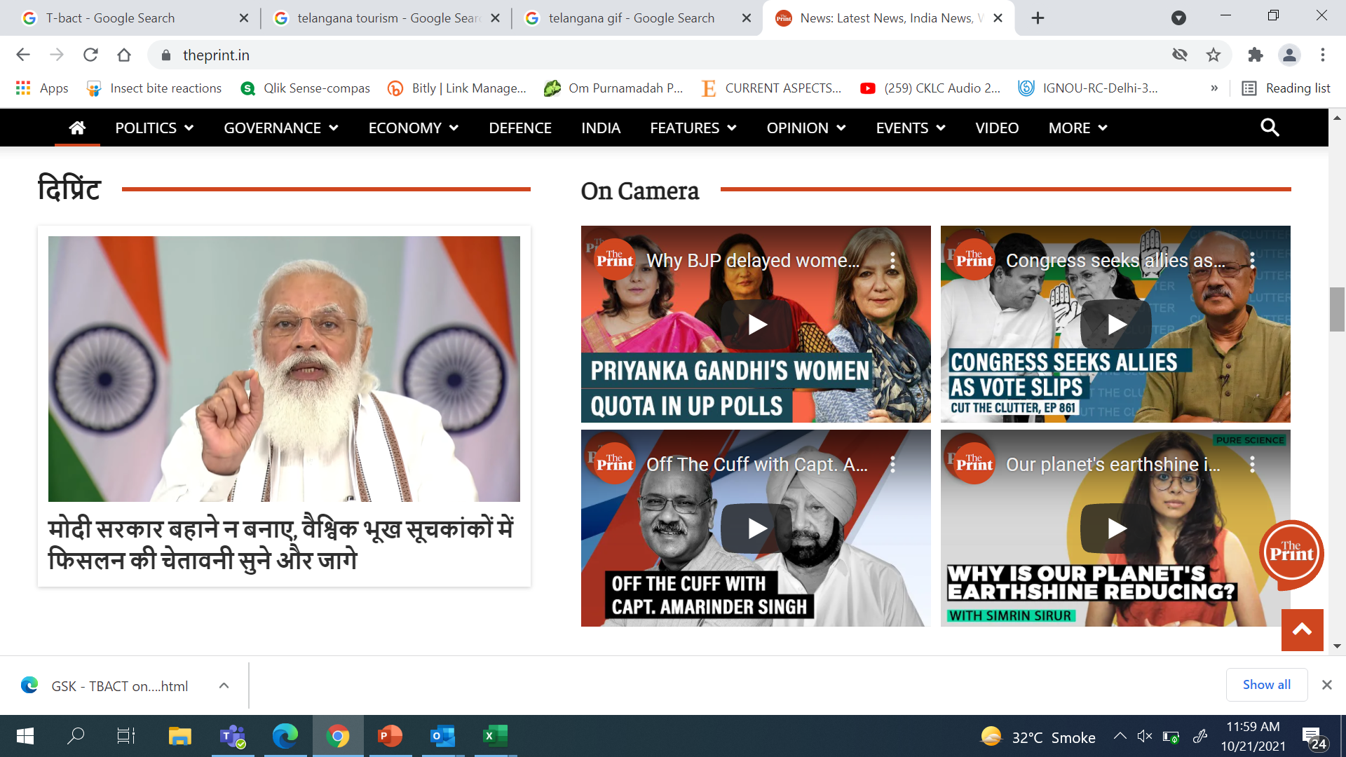
Comparison with similar news banners
Depth and Context Images
Images can help you to attract attention and to guide your visitor's line of sight.
Clear CTA
Without a clear CTA, the user may not know the next steps to take to purchase a product or sign up for a newsletter and is likely to leave the site without accomplishing their task.
Multilingual
Customers who can understand your content in their language are more likely to tell like-minded people creating familiarity and repeat business. You can truly become a 'global' brand once you offer a multilingual function on your website.
Video format

Slide 33
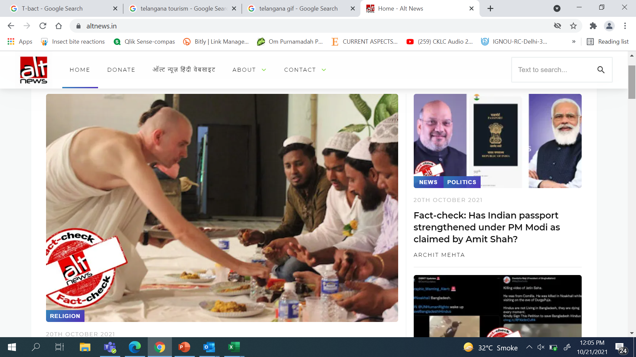
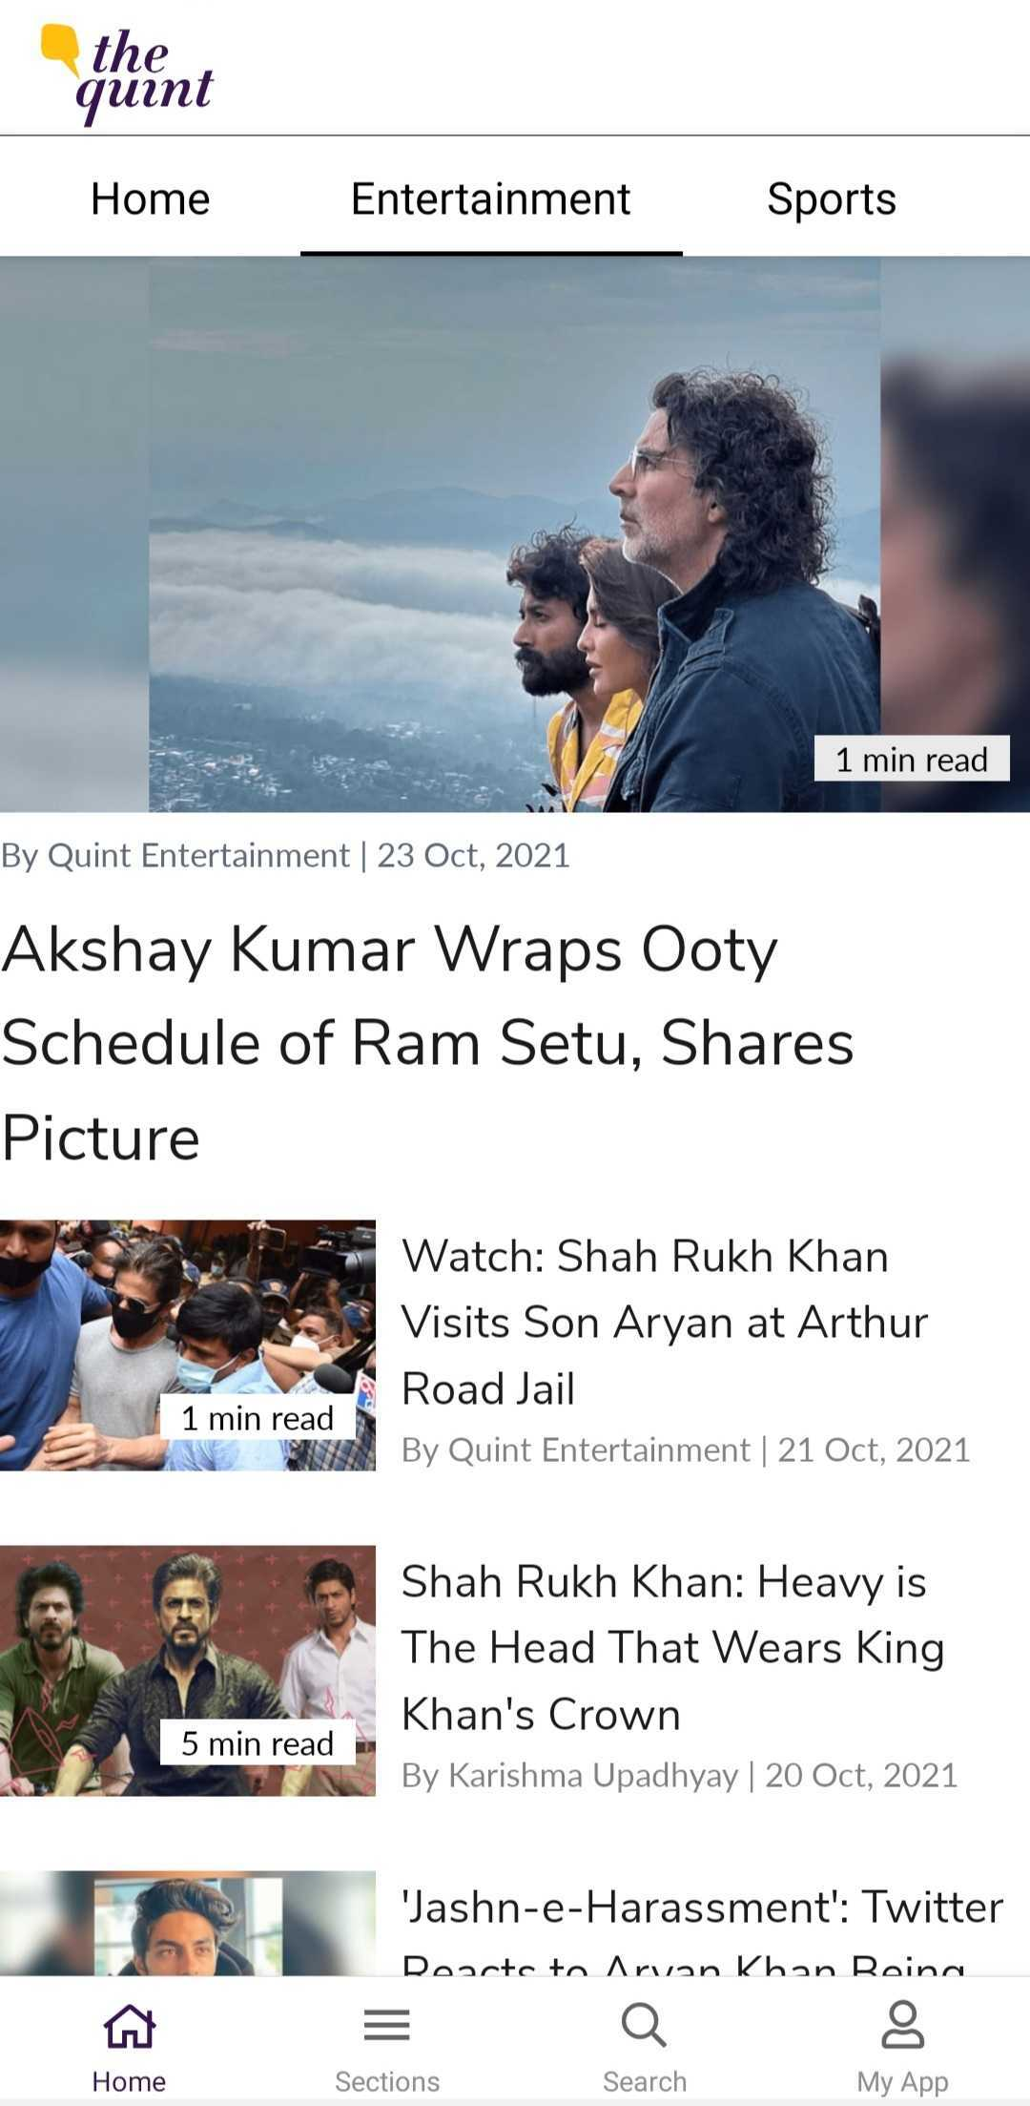
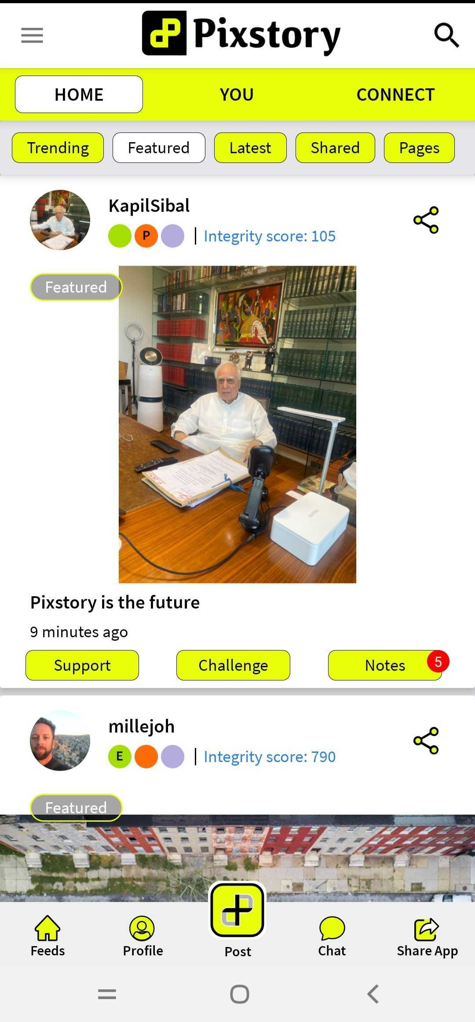
The Quint:
Very segregated content | Format wise and feature wise
ALT News:
Well branded | The POD is evident in each frame
Pixstory:
Unique features
Tiled content placement

Slide 34
THANK YOU
Thank you for your attention. For information or questions, please feel free to ask at the end of this session or contact us

Slide 35
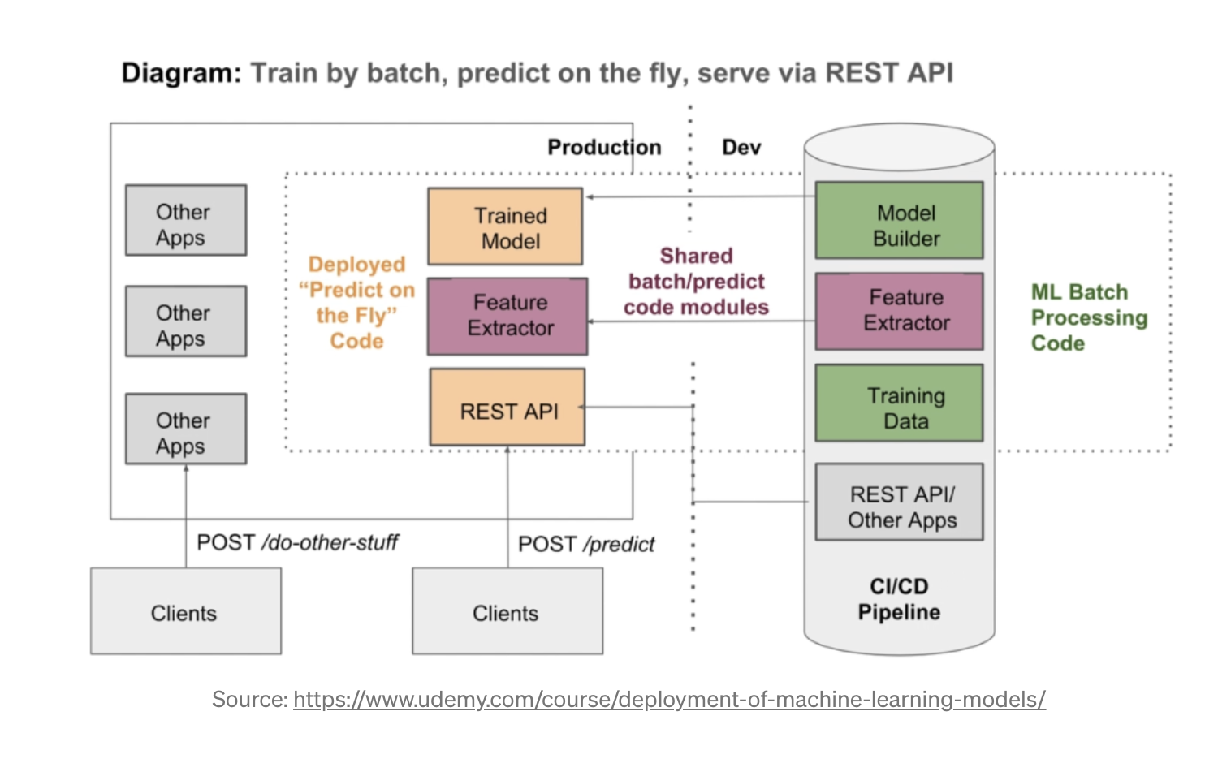
DEPLOYMENT WITH REST API’S

